Slide 1

Slide 17- <number>

Slide 2
Chapter 17
Introduction to Transaction Processing Concepts and Theory
Copyright © 2007 Ramez Elmasri and Shamkant B. Navathe

Slide 3
Chapter Outline
1 Introduction to Transaction Processing
2 Transaction and System Concepts
3 Desirable Properties of Transactions
4 Characterizing Schedules based on Recoverability
5 Characterizing Schedules based on Serializability
6 Transaction Support in SQL
Slide 17- <number>

Slide 4
1 Introduction to Transaction Processing (1)
Single-User System:
  At most one user at a time can use the system.
Multiuser System:
  Many users can access the system concurrently.
Concurrency
  Interleaved processing:
    Concurrent execution of processes is interleaved in a single CPU
  Parallel processing:
    Processes are concurrently executed in multiple CPUs.
Slide 17- <number>

Slide 5
Introduction to Transaction Processing (2)
A Transaction:
  Logical unit of database processing that includes one or more access operations (read -retrieval, write - insert or update, delete).
A transaction (set of operations) may be stand-alone specified in a high level language like SQL submitted interactively, or may be embedded within a program.
Transaction boundaries:
  Begin and End transaction.
An application program may contain several transactions separated by the Begin and End transaction boundaries.
Slide 17- <number>

Slide 6
Introduction to Transaction Processing (3)
SIMPLE MODEL OF A DATABASE (for purposes of discussing transactions):
A database is a collection of named data items
Granularity of data - a field, a record , or a whole disk block (Concepts are independent of granularity)
Basic operations are read and write
  read_item(X): Reads a database item named X into a program variable. To simplify our notation, we assume that the program variable is also named X.
  write_item(X): Writes the value of program variable X into the database item named X.
Slide 17- <number>

Slide 7
Introduction to Transaction Processing (4)
READ AND WRITE OPERATIONS:
Basic unit of data transfer from the disk to the computer main memory is one block. In general, a data item (what is read or written) will be the field of some record in the database, although it may be a larger unit such as a record or even a whole block.
read_item(X) command includes the following steps:
  Find the address of the disk block that contains item X.
  Copy that disk block into a buffer in main memory (if that disk block is not already in some main memory buffer).
  Copy item X from the buffer to the program variable named X.
Slide 17- <number>

Slide 8
Introduction to Transaction Processing (5)
READ AND WRITE OPERATIONS (contd.):
write_item(X) command includes the following steps:
  Find the address of the disk block that contains item X.
  Copy that disk block into a buffer in main memory (if that disk block is not already in some main memory buffer).
  Copy item X from the program variable named X into its correct location in the buffer.
  Store the updated block from the buffer back to disk (either immediately or at some later point in time).
Slide 17- <number>

Slide 9

Two sample transactions
FIGURE 17.2 Two sample transactions:
  (a) Transaction T1
  (b) Transaction T2
Slide 17- <number>

Slide 10
Introduction to Transaction Processing (6)
Why Concurrency Control is needed:
The Lost Update Problem
  This occurs when two transactions that access the same database items have their operations interleaved in a way that makes the value of some database item incorrect.
The Temporary Update (or Dirty Read) Problem
  This occurs when one transaction updates a database item and then the transaction fails for some reason (see Section 17.1.4).
  The updated item is accessed by another transaction before it is changed back to its original value.
The Incorrect Summary Problem
  If one transaction is calculating an aggregate summary function on a number of records while other transactions are updating some of these records, the aggregate function may calculate some values before they are updated and others after they are updated.
Slide 17- <number>

Slide 11
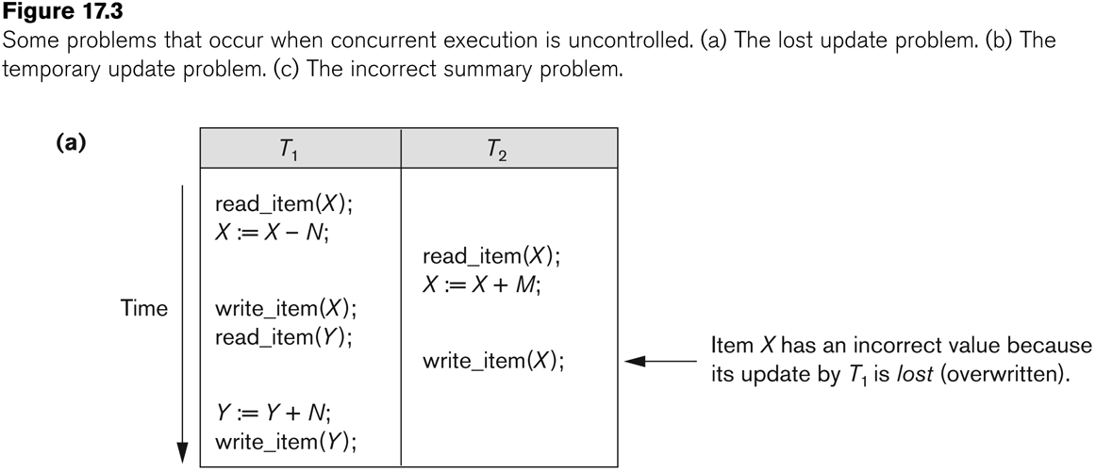
Concurrent execution is uncontrolled: (a) The lost update problem.
Slide 17- <number>

Slide 12
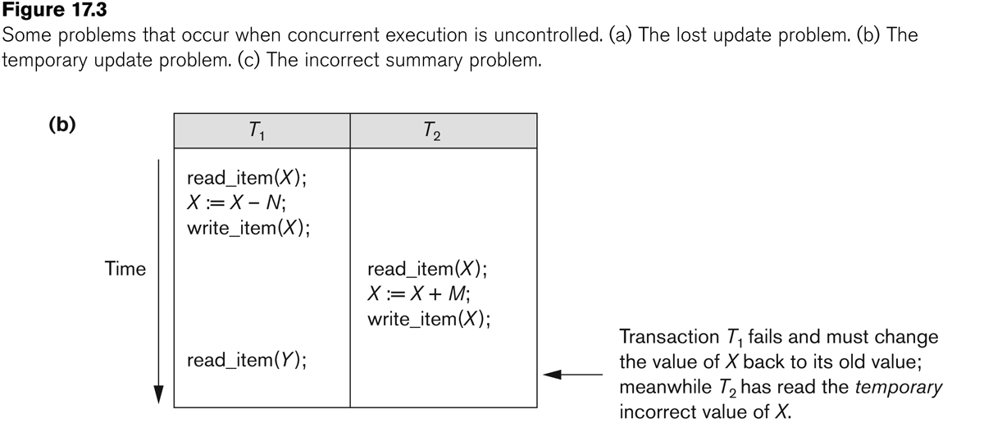
Concurrent execution is uncontrolled: (b) The temporary update problem.
Slide 17- <number>

Slide 13
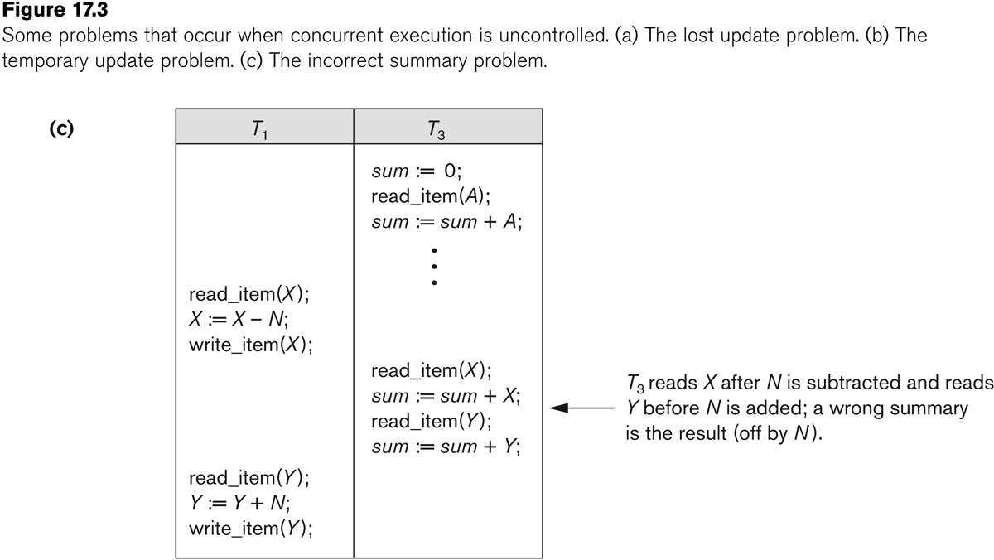
Concurrent execution is uncontrolled: (c) The incorrect summary problem.
Slide 17- <number>

Slide 14
Introduction to Transaction Processing
Why recovery is needed:
(What causes a Transaction to fail)
  1. A computer failure (system crash):
    A hardware or software error occurs in the computer system during transaction execution. If the hardware crashes, the contents of the computer’s internal memory may be lost.
  2. A transaction or system error:
    Some operation in the transaction may cause it to fail, such as integer overflow or division by zero. Transaction failure may also occur because of erroneous parameter values or because of a logical programming error. In addition, the user may interrupt the transaction during its execution.
Slide 17- <number>

Slide 15
Introduction to Transaction Processing
Why recovery is needed (Contd.):
(What causes a Transaction to fail)
  3. Local errors or exception conditions detected by the transaction:
    Certain conditions necessitate cancellation of the transaction. For example, data for the transaction may not be found. A condition, such as insufficient account balance in a banking database, may cause a transaction, such as a fund withdrawal from that account, to be canceled.
    A programmed abort in the transaction causes it to fail.
  4. Concurrency control enforcement:
    The concurrency control method may decide to abort the transaction, to be restarted later, because it violates serializability or because several transactions are in a state of deadlock .
Slide 17- <number>

Slide 16
Introduction to Transaction Processing
Why recovery is needed (contd.):
(What causes a Transaction to fail)
  5. Disk failure:
    Some disk blocks may lose their data because of a read or write malfunction or because of a disk read/write head crash. This may happen during a read or a write operation of the transaction.
  6. Physical problems and catastrophes:
    This refers to an endless list of problems that includes power or air-conditioning failure, fire, theft, sabotage, overwriting disks or tapes by mistake, and mounting of a wrong tape by the operator.
Slide 17- <number>

Slide 17
Transaction and System Concepts
A transaction is an atomic unit of work that is either completed in its entirety or not done at all.
  For recovery purposes, the system needs to keep track of when the transaction starts, terminates, and commits or aborts.
Transaction states:
  Active state
  Partially committed state
  Committed state
  Failed state
  Terminated State
Slide 17- <number>

Slide 18
Transaction and System Concepts
Recovery manager keeps track of the following operations:
  begin_transaction: This marks the beginning of transaction execution.
  read or write: These specify read or write operations on the database items that are executed as part of a transaction.
  end_transaction: This specifies that read and write transaction operations have ended and marks the end limit of transaction execution.
    At this point it may be necessary to check whether the changes introduced by the transaction can be permanently applied to the database or whether the transaction has to be aborted because it violates concurrency control or for some other reason.
Slide 17- <number>

Slide 19
Transaction and System Concepts
Recovery manager keeps track of the following operations (cont):
  commit_transaction: This signals a successful end of the transaction so that any changes (updates) executed by the transaction can be safely committed to the database and will not be undone.
  rollback (or abort): This signals that the transaction has ended unsuccessfully, so that any changes or effects that the transaction may have applied to the database must be undone.
Slide 17- <number>

Slide 20
Transaction and System Concepts (4)
Recovery techniques use the following operators:
  undo: Similar to rollback except that it applies to a single operation rather than to a whole transaction.
  redo: This specifies that certain transaction operations must be redone to ensure that all the operations of a committed transaction have been applied successfully to the database.
Slide 17- <number>

Slide 21
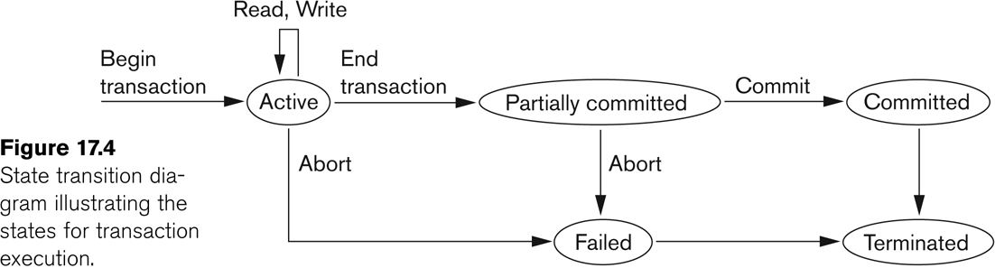
State transition diagram illustrating the states for transaction execution
Slide 17- <number>

Slide 22
Transaction and System Concepts
The System Log
  Log or Journal: The log keeps track of all transaction operations that affect the values of database items.
    This information may be needed to permit recovery from transaction failures.
    The log is kept on disk, so it is not affected by any type of failure except for disk or catastrophic failure.
    In addition, the log is periodically backed up to archival storage (tape) to guard against such catastrophic failures.
Slide 17- <number>

Slide 23
Transaction and System Concepts
The System Log (cont):
  T in the following discussion refers to a unique transaction-id that is generated automatically by the system and is used to identify each transaction:
  Types of log record:
    [start_transaction,T]: Records that transaction T has started execution.
    [write_item,T,X,old_value,new_value]: Records that transaction T has changed the value of database item X from old_value to new_value.
    [read_item,T,X]: Records that transaction T has read the value of database item X.
    [commit,T]: Records that transaction T has completed successfully, and affirms that its effect can be committed (recorded permanently) to the database.
    [abort,T]: Records that transaction T has been aborted.
Slide 17- <number>

Slide 24
Transaction and System Concepts
Recovery using log records:
If the system crashes, we can recover to a consistent database state by examining the log and using one of the techniques described in Chapter 19.
  Because the log contains a record of every write operation that changes the value of some database item, it is possible to undo the effect of these write operations of a transaction T by tracing backward through the log and resetting all items changed by a write operation of T to their old_values.
  We can also redo the effect of the write operations of a transaction T by tracing forward through the log and setting all items changed by a write operation of T (that did not get done permanently) to their new_values.
Slide 17- <number>

Slide 25
Transaction and System Concepts
Commit Point of a Transaction:
Definition a Commit Point:
  A transaction T reaches its commit point when all its operations that access the database have been executed successfully and the effect of all the transaction operations on the database has been recorded in the log.
  Beyond the commit point, the transaction is said to be committed, and its effect is assumed to be permanently recorded in the database.
  The transaction then writes an entry [commit,T] into the log.
Roll Back of transactions:
  Needed for transactions that have a [start_transaction,T] entry into the log but no commit entry [commit,T] into the log.
Slide 17- <number>

Slide 26
3 Desirable Properties of Transactions
ACID properties:
Atomicity: A transaction is an atomic unit of processing; it is either performed in its entirety or not performed at all. Also called as ‘All or Nothing Rule’.
Consistency preservation: A correct execution of the transaction must take the database from one consistent state to another.
-DB must be consistent before and after transaction.
Isolation: A transaction should not make its updates visible to other transactions until it is committed; this property, when enforced strictly, solves the temporary update problem and makes cascading rollbacks of transactions unnecessary.
-Multiple transactions occur independently without interference
Durability or permanency: Once a transaction changes the database and the changes are committed, these changes must never be lost because of subsequent failure.
Slide 17- <number>

Slide 27
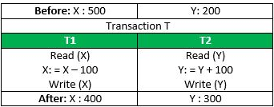
Consider the following transaction T consisting of T1 and T2: Transfer of 100 from account X to account Y.
If the transaction fails after completion of T1 but before completion of T2.( say, after write(X) but before write(Y)), then amount has been deducted from X but not added to Y. This results in an inconsistent database state. Therefore, the transaction must be executed in entirety in order to ensure correctness of database state.
Consistency
This means that integrity constraints must be maintained so that the database is consistent before and after the transaction. It refers to the correctness of a database. Referring to the example above,
The total amount before and after the transaction must be maintained.
Total before T occurs = 500 + 200 = 700.
Total after T occurs = 400 + 300 = 700.
Therefore, database is consistent. Inconsistency occurs in case T1 completes but T2 fails. As a result T is incomplete.
Slide 17- <number>

Slide 28
Characterizing Schedules based on Recoverability
Transaction schedule or history:
  When transactions are executing concurrently in an interleaved fashion, the order of execution of operations from the various transactions forms what is known as a transaction schedule (or history).
A schedule (or history) S of n transactions T1, T2, …, Tn:
  It is an ordering of the operations of the transactions subject to the constraint that, for each transaction Ti that participates in S, the operations of T1 in S must appear in the same order in which they occur in T1.
  Note, however, that operations from other transactions Tj can be interleaved with the operations of Ti in S.
Slide 17- <number>

Slide 29
Characterizing Schedules based on Recoverability
Schedules classified on recoverability:
Recoverable schedule:
  One where no transaction needs to be rolled back.
  A schedule S is recoverable if no transaction T in S commits until all transactions T’ that have written an item that T reads have committed.
Cascadeless schedule:
  One where every transaction reads only the items that are written by committed transactions.
Slide 17- <number>

Slide 30
Characterizing Schedules based on Recoverability
Schedules classified on recoverability (contd.):
Schedules requiring cascaded rollback:
  A schedule in which uncommitted transactions that read an item from a failed transaction must be rolled back.
Strict Schedules:
  A schedule in which a transaction can neither read or write an item X until the last transaction that wrote X has committed.
Slide 17- <number>

Slide 31
Characterizing Schedules based on Serializability
Serial schedule:
  A schedule S is serial if, for every transaction T participating in the schedule, all the operations of T are executed consecutively in the schedule.
    Otherwise, the schedule is called nonserial schedule.
Serializable schedule:
  A schedule S is serializable if it is equivalent to some serial schedule of the same n transactions.
Slide 17- <number>

Slide 32
Characterizing Schedules based on Serializability
Result equivalent:
  Two schedules are called result equivalent if they produce the same final state of the database.
Conflict equivalent:
  Two schedules are said to be conflict equivalent if the order of any two conflicting operations is the same in both schedules.
Conflict serializable:
  A schedule S is said to be conflict serializable if it is conflict equivalent to some serial schedule S’.
Slide 17- <number>

Slide 33
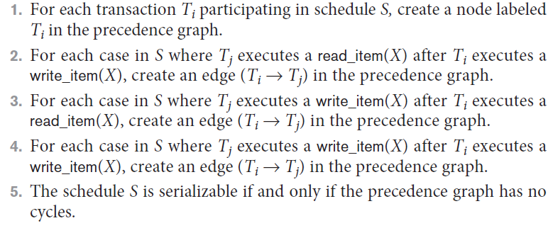
Characterizing Schedules Based on Serializability (cont’d.)
Testing for serializability of a schedule
Algorithm 20.1 Testing conflict serializability of a schedule S
Slide 20- <number>

Slide 34
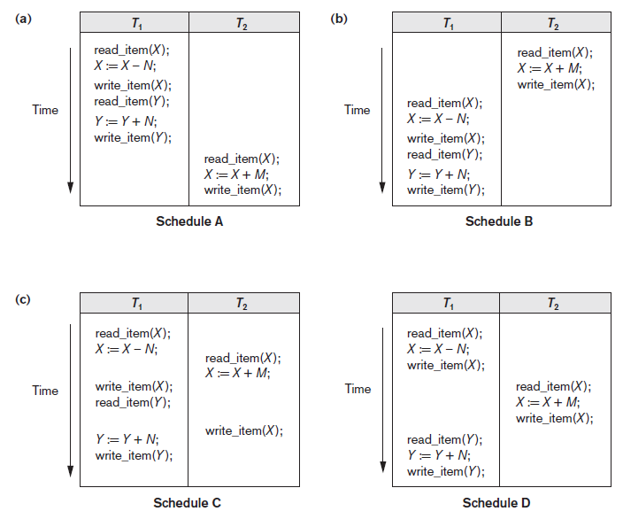
Figure 20.5 Examples of serial and nonserial schedules involving transactions T1 and T2 (a) Serial schedule A: T1 followed by T2 (b) Serial schedule B: T2 followed by T1 (c) Two nonserial schedules C and D with interleaving of operations
Slide 20-<number>

Slide 35
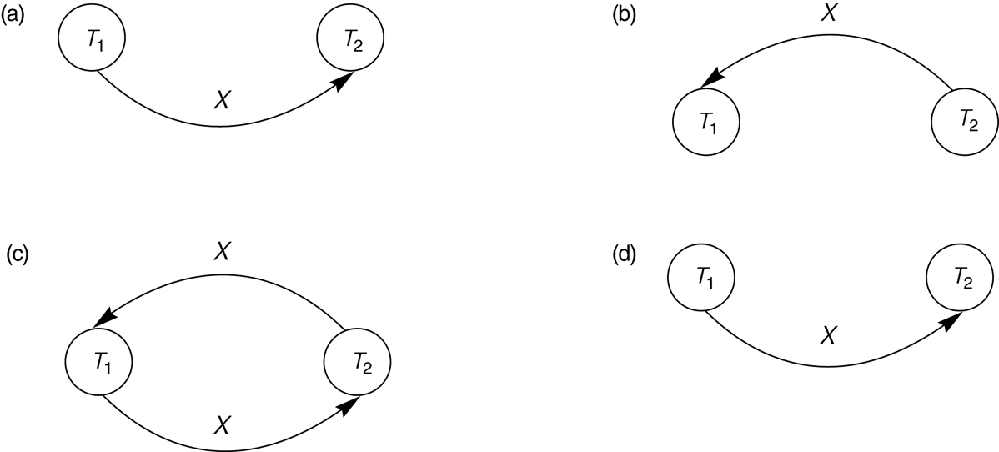
Constructing the Precedence Graphs
FIGURE 17.7 Constructing the precedence graphs for schedules A and D from Figure 17.5 to test for conflict serializability.
  (a) Precedence graph for serial schedule A.
  (b) Precedence graph for serial schedule B.
  (c) Precedence graph for schedule C (not serializable).
  (d) Precedence graph for schedule D (serializable, equivalent to schedule A).
Slide 17- <number>

Slide 36
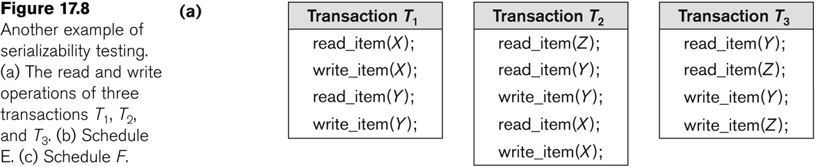
Another example of serializability Testing
Slide 17- <number>

Slide 37
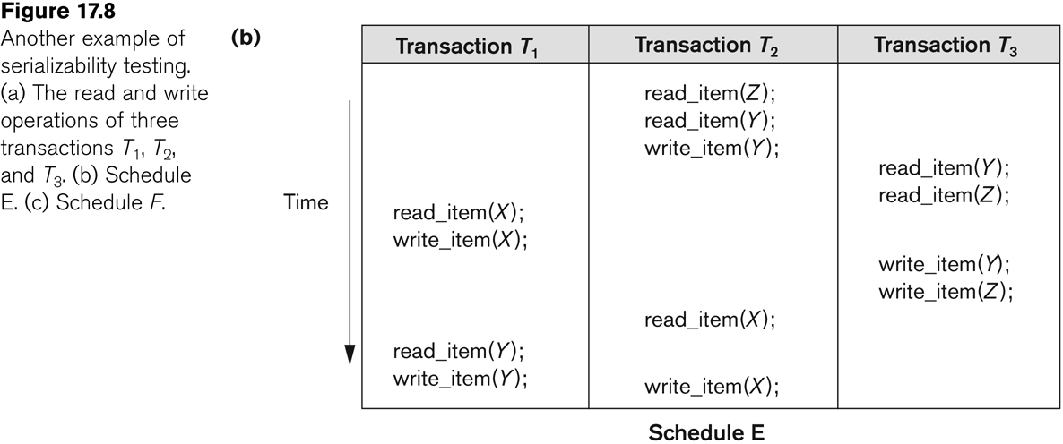
Another Example of Serializability Testing
Slide 17- <number>

Slide 38
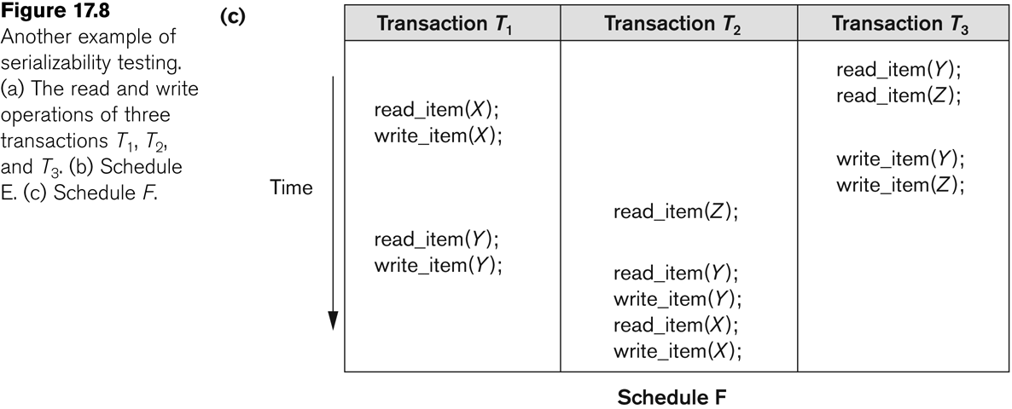
Another Example of Serializability Testing
Slide 17- <number>

Slide 39
Which of the following Schedules is conflict serializable? For each serializable schedule , determine equivalent serial schedules
a). r1(X); r3(X); w1(X); r2(X); w3(X);
b). r1(X); r3(X); w3(X); w1(X); r2(X);
c). r3(X); r2(X); w3(X); r1(X); w1(X);
d). r3(X); r2(X); r1(X); w3(X); w1(X);
Slide 17- <number>

Slide 40
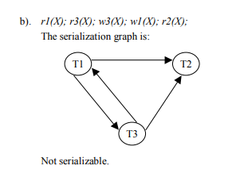
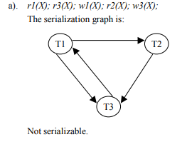
Solution
X
X
X
X
X
X
X
X
Slide 17- <number>

Slide 41
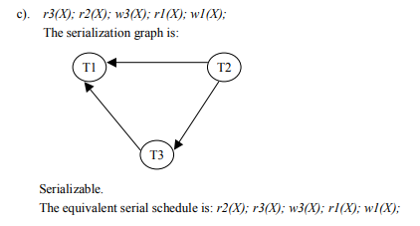
Solution
X
X
X
Slide 17- <number>

Slide 42

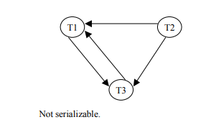
Solution
X
X
X
X
Slide 17- <number>

Slide 43
Characterizing Schedules Based on Recoverability
A shorthand notation for describing a schedule uses the symbols b, r, w, e, c, and a for the operations
begin_transaction, read_item, write_item, end_transaction, commit, and abort, respectively
Slide 17- <number>

Slide 44
Schedules
S_{a}: r₁(X); r₂(X); w₁(X); r₁(Y); w₂(X); w₁(Y);
Same as S_{a} except 2 commit operations
S_{b}: r₁(X); r₂(X); w₁(X); r₁(Y); w₂(X);c₂; w₁(Y);c₁
S_{b} is recoverable , even though it suffers from lost update problem
S_{c}: r₁(X); w₁(X); r₂(X); r₁(Y); w₂(X); c₂ ;a₁;
Is not recoverable because T2 reads item X from T1, and the T2 commits before T1 commits.
Slide 17- <number>

Slide 45
Isolation levels in Transaction Processing
A transaction isolation level is defined by the following phenomena –
Dirty Read – A Dirty read is the situation when a transaction reads a data that has not yet been committed.
Non Repeatable read – Non Repeatable read occurs when a transaction reads same row twice, and get a different value each time.
Phantom Read – Phantom Read occurs when two same queries are executed, but the rows retrieved by the two, are different.
Based on these phenomena, The SQL standard defines four isolation levels :
Slide 17- <number>

Slide 46
Isolation levels in Transaction Processing
Read Uncommitted – Read Uncommitted is the lowest isolation level. In this level, one transaction may read not yet committed changes made by other transaction, thereby allowing dirty reads. In this level, transactions are not isolated from each other.
Read Committed – This isolation level guarantees that any data read is committed at the moment it is read. Thus it does not allows dirty read. The transaction holds a read or write lock on the current row, and thus prevent other transactions from reading, updating or deleting it.
Slide 17- <number>

Slide 47
Isolation levels in Transaction Processing
Repeatable Read – This is the most restrictive isolation level. The transaction holds read locks on all rows it references and writes locks on all rows it inserts, updates, or deletes. Since other transaction cannot read, update or delete these rows, consequently it avoids non-repeatable read.
Serializable – This is the Highest isolation level. A serializable execution is guaranteed to be serializable. Serializable execution is defined to be an execution of operations in which concurrently executing transactions appears to be serially executing.
Slide 17- <number>

Slide 48
Characterizing Schedules based on Serializability (3)
Being serializable is not the same as being serial
Being serializable implies that the schedule is a correct schedule.
  It will leave the database in a consistent state.
  The interleaving is appropriate and will result in a state as if the transactions were serially executed, yet will achieve efficiency due to concurrent execution.
Slide 17- <number>

Slide 49
Characterizing Schedules based on Serializability (4)
Serializability is hard to check.
  Interleaving of operations occurs in an operating system through some scheduler
  Difficult to determine beforehand how the operations in a schedule will be interleaved.
Slide 17- <number>

Slide 50
Characterizing Schedules based on Serializability (5)
Practical approach:
Come up with methods (protocols) to ensure serializability.
It’s not possible to determine when a schedule begins and when it ends.
  Hence, we reduce the problem of checking the whole schedule to checking only a committed project of the schedule (i.e. operations from only the committed transactions.)
Current approach used in most DBMSs:
  Use of locks with two phase locking
Slide 17- <number>

Slide 51
Characterizing Schedules based on Serializability (6)
View equivalence:
  A less restrictive definition of equivalence of schedules
View serializability:
  Definition of serializability based on view equivalence.
  A schedule is view serializable if it is view equivalent to a serial schedule.
Slide 17- <number>

Slide 52
Characterizing Schedules based on Serializability (7)
Two schedules are said to be view equivalent if the following three conditions hold:
  The same set of transactions participates in S and S’, and S and S’ include the same operations of those transactions.
  For any operation Ri(X) of Ti in S, if the value of X read by the operation has been written by an operation Wj(X) of Tj (or if it is the original value of X before the schedule started), the same condition must hold for the value of X read by operation Ri(X) of Ti in S’.
  If the operation Wk(Y) of Tk is the last operation to write item Y in S, then Wk(Y) of Tk must also be the last operation to write item Y in S’.
Slide 17- <number>

Slide 53
Characterizing Schedules based on Serializability (8)
The premise behind view equivalence:
  As long as each read operation of a transaction reads the result of the same write operation in both schedules, the write operations of each transaction must produce the same results.
  “The view”: the read operations are said to see the same view in both schedules.
Slide 17- <number>

Slide 54
Characterizing Schedules based on Serializability (9)
Relationship between view and conflict equivalence:
  The two are same under constrained write assumption which assumes that if T writes X, it is constrained by the value of X it read; i.e., new X = f(old X)
  Conflict serializability is stricter than view serializability. With unconstrained write (or blind write), a schedule that is view serializable is not necessarily conflict serializable.
  Any conflict serializable schedule is also view serializable, but not vice versa.
Slide 17- <number>

Slide 55
Characterizing Schedules based on Serializability (10)
Relationship between view and conflict equivalence (cont):
  Consider the following schedule of three transactions
    T1: r1(X), w1(X); T2: w2(X); and T3: w3(X):
  Schedule Sa: r1(X); w2(X); w1(X); w3(X); c1; c2; c3;
In Sa, the operations w2(X) and w3(X) are blind writes, since T1 and T3 do not read the value of X.
  Sa is view serializable, since it is view equivalent to the serial schedule T1, T2, T3.
  However, Sa is not conflict serializable, since it is not conflict equivalent to any serial schedule.
Slide 17- <number>

Slide 56
Characterizing Schedules based on Serializability (14)
Other Types of Equivalence of Schedules
Under special semantic constraints, schedules that are otherwise not conflict serializable may work correctly.
  Using commutative operations of addition and subtraction (which can be done in any order) certain non-serializable transactions may work correctly
Slide 17- <number>

Slide 57
Characterizing Schedules based on Serializability (15)
Other Types of Equivalence of Schedules (contd.)
Example: bank credit / debit transactions on a given item are separable and commutative.
  Consider the following schedule S for the two transactions:
  Sh : r1(X); w1(X); r2(Y); w2(Y); r1(Y); w1(Y); r2(X); w2(X);
  Using conflict serializability, it is not serializable.
  However, if it came from a (read,update, write) sequence as follows:
    r1(X); X := X – 10; w1(X); r2(Y); Y := Y – 20;r1(Y);
    Y := Y + 10; w1(Y); r2(X); X := X + 20; (X);
  Sequence explanation: debit, debit, credit, credit.
  It is a correct schedule for the given semantics
Slide 17- <number>

Slide 58
6 Transaction Support in SQL2 (1)
A single SQL statement is always considered to be atomic.
  Either the statement completes execution without error or it fails and leaves the database unchanged.
With SQL, there is no explicit Begin Transaction statement.
  Transaction initiation is done implicitly when particular SQL statements are encountered.
Every transaction must have an explicit end statement, which is either a COMMIT or ROLLBACK.
Slide 17- <number>

Slide 59
Transaction Support in SQL2 (2)
Characteristics specified by a SET TRANSACTION statement in SQL2:
Access mode:
  READ ONLY or READ WRITE.
    The default is READ WRITE unless the isolation level of READ UNCOMITTED is specified, in which case READ ONLY is assumed.
Diagnostic size n, specifies an integer value n, indicating the number of conditions that can be held simultaneously in the diagnostic area.
Slide 17- <number>

Slide 60
Transaction Support in SQL2 (3)
Characteristics specified by a SET TRANSACTION statement in SQL2 (contd.):
Isolation level <isolation>, where <isolation> can be READ UNCOMMITTED, READ COMMITTED, REPEATABLE READ or SERIALIZABLE. The default is SERIALIZABLE.
  With SERIALIZABLE: the interleaved execution of transactions will adhere to our notion of serializability.
  However, if any transaction executes at a lower level, then serializability may be violated.
Slide 17- <number>

Slide 61
Transaction Support in SQL2 (4)
Potential problem with lower isolation levels:
Dirty Read:
  Reading a value that was written by a transaction which failed.
Nonrepeatable Read:
  Allowing another transaction to write a new value between multiple reads of one transaction.
  A transaction T1 may read a given value from a table. If another transaction T2 later updates that value and T1 reads that value again, T1 will see a different value.
    Consider that T1 reads the employee salary for Smith. Next, T2 updates the salary for Smith. If T1 reads Smith's salary again, then it will see a different value for Smith's salary.
Slide 17- <number>

Slide 62
Transaction Support in SQL2 (5)
Potential problem with lower isolation levels (contd.):
  Phantoms:
    New rows being read using the same read with a condition.
      A transaction T1 may read a set of rows from a table, perhaps based on some condition specified in the SQL WHERE clause.
      Now suppose that a transaction T2 inserts a new row that also satisfies the WHERE clause condition of T1, into the table used by T1.
      If T1 is repeated, then T1 will see a row that previously did not exist, called a phantom.
Slide 17- <number>

Slide 63
Transaction Support in SQL2 (6)
Sample SQL transaction:
  EXEC SQL whenever sqlerror go to UNDO;
  EXEC SQL SET TRANSACTION
  READ WRITE
  DIAGNOSTICS SIZE 5
  ISOLATION LEVEL SERIALIZABLE;
  EXEC SQL INSERT
  INTO EMPLOYEE (FNAME, LNAME, SSN, DNO, SALARY)
  VALUES ('Robert','Smith','991004321',2,35000);
  EXEC SQL UPDATE EMPLOYEE
  SET SALARY = SALARY * 1.1
  WHERE DNO = 2;
  EXEC SQL COMMIT;
  GOTO THE_END;
  UNDO: EXEC SQL ROLLBACK;
  THE_END: ...
Slide 17- <number>

Slide 64
Transaction Support in SQL2 (7)
Possible violation of serializabilty:
Type of Violation
Isolation Dirty nonrepeatable
level read read phantom
_______________________________________________________
READ UNCOMMITTED yes yes yes
READ COMMITTED no yes yes
REPEATABLE READ no no yes
SERIALIZABLE no no no
Slide 17- <number>

Slide 65
Summary
Transaction and System Concepts
Desirable Properties of Transactions
Characterizing Schedules based on Recoverability
Characterizing Schedules based on Serializability
Transaction Support in SQL
Slide 17- <number>

